Slide 1


Advanced Driving Assistance System (ADAS)
Presented By Team: 7

Slide 2

TEAM MEMBERS
NAME | ID
Abanob Malak | 95689
Kareem Ahmed | 95635
Omar Mohamed | 95668
Magdy Maged | 91672
Essam Alaa | 91679

Slide 3
TABLE OF CONTENTS
01
02
03
04
05
06
INTRODUCTION
Steering Angle Calculations
Blind Spot Detection
Forward Collision Warning
Lane Departure
Conclusion

Slide 4

01
INTRODUCTION

Slide 5
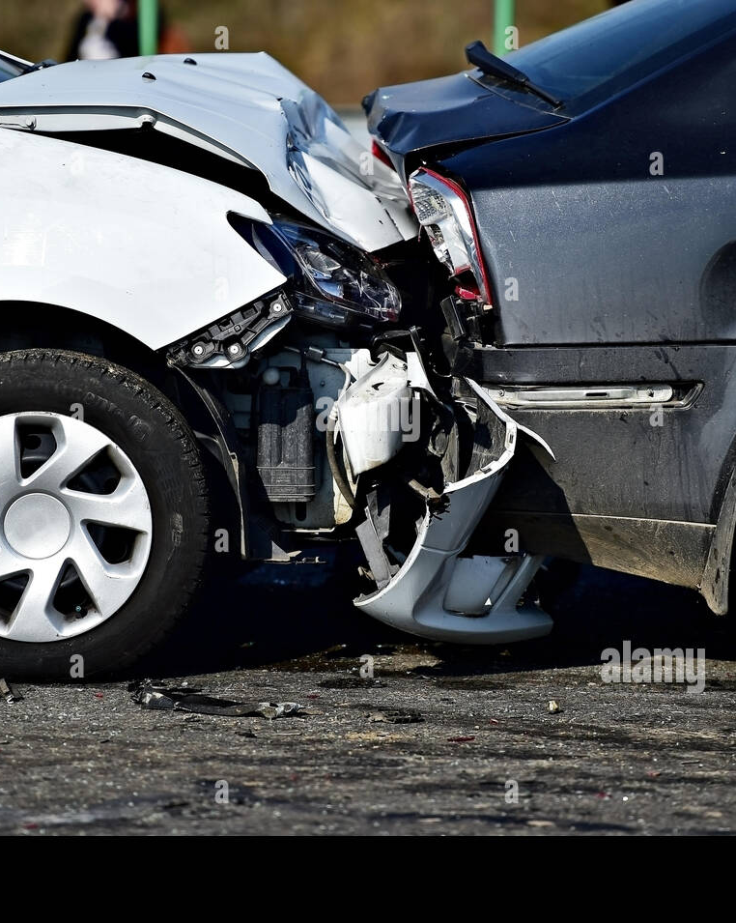
PROBLEM STATEMENT
A driver is one of the “best sensors in the vehicle” and is primarily responsible for avoiding crashes. But still, a large proportion of crashes are attributed to driver errors. These errors included recognition, decision, performance, and nonperformance errors. These errors are predominantly due to misjudgments of the driver, poor directional control, inattention, sleeping, and fatigue.

Slide 6
Statistics in 2023
71,016
25%
67.5
road accident injuries
Increased Compared to pervious year
Injury Rate per 100,000 people

Slide 7
Project Objective
ADAS can work an important role in many factors to reduce the number of these cases as possible using the power of sensors and Machine learning algorithms to analyze the environment around the vehicle and take the required action in the suitable time, these factors are:
Blind Spot Detection System.
Forward Collision Warning.
Lane Departure System.

Slide 8
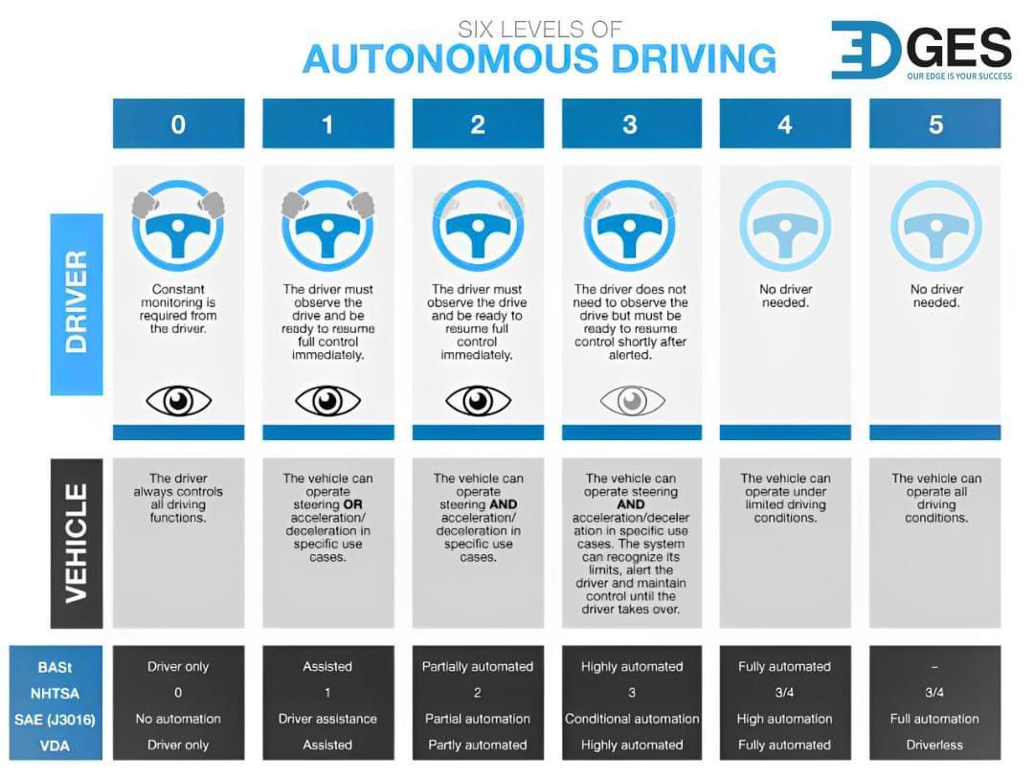

Slide 9
Project Phases
Phase 1
Planning and Requirements Gathering
Phase 2
Conceptual Design and Literature Review
Phase 3
Prototype and Simulation Design
Objective: Define clear goals for each feature (Ackerman chassis, blind spot detection, etc.)
Objective: Define and design the ADAS features at a high level.
Objective: Begin simulating individual components and test integration.
System Integration and Full Simulation
Phase 4
Objective: Combine all components into a unified system and simulate the complete ADAS system

Slide 10
TABLE OF CONTENTS
01
02
03
04
05
06
INTRODUCTION
Steering Angle Calculations
Blind Spot Detection
Forward Collision Warning
Lane Departure
Conclusion

Slide 11
02
Steering Angle Calculations

Slide 12
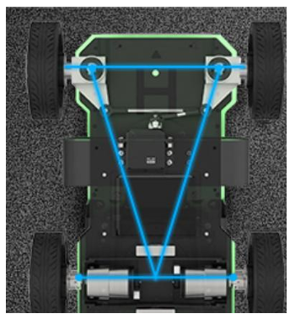
The robot is built with an Ackerman chassis structure, allowing it to be driven by the rear wheel while being controlled by the front wheel. The front wheel steering mechanism resembles that of a real car, enabling basic driving functions such as forward movement, reverse, and wide-radius steering. However, it does not support in-place steering. The Ackerman chassis offers not only excellent steering capabilities but also a certain degree of climbing ability.
Steering Angle Calculations

Slide 13
The driving mechanism consists of servos, links, and wheels. The servos are connected to the links, and these links, in turn, are connected to the wheels. By rotating the servos, the movement of the links is controlled, thereby determining the turning direction of the front wheels.
Steering Angle Calculations

Slide 14
TABLE OF CONTENTS
01
02
03
04
05
06
INTRODUCTION
Steering Angle Calculations
Blind Spot Detection
Forward Collision Warning
Lane Departure
Conclusion

Slide 15
03
Blind Spot Detection

Slide 16
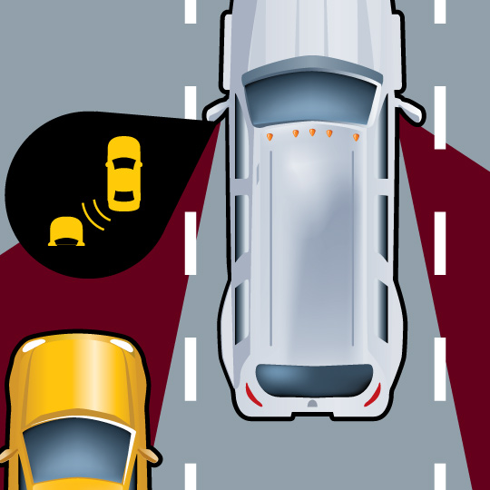
Blind spots in vehicles have long been a safety concern, contributing to significant number of accidents. The Blind Spot Detection System is designed to mitigate these risks by employing advanced sensor technologies to monitor and alert drivers about objects or vehicles in their blind spots.
INTRODUCTION

Slide 17
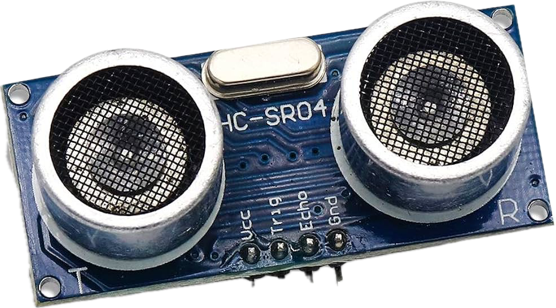
Ultrasonic sensor uses sound to measure the distance. It transmits an ultrasound signal, when the sound reflects from any object it will be detected by the sensor. Then the sound travels double the distance to go over the object and turn back to the sensor. This is how the sensor measures the distance.
ULTRASONIC SENSOR

Slide 18
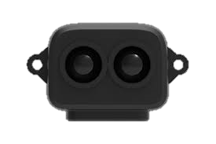
The TF Luna LiDAR sensor uses light to measure distance. It transmits a brief infrared light pulse, and when this light reflects off any object, it will be detected by the sensor. The light travels double the distance to reach the object and return to the sensor
TF-LUNA LIDAR

Slide 19

From the measurements of the object’s position, we can make a threshold to alert the driver at danger. If the object is almost to crash the car, the car itself can make an action to the other direction to prevent the accident.
Alert System

Slide 20
The Blind Spot Detection System stands as a critical innovation in automotive safety, addressing a long-standing concern and significantly enhancing the driver's ability to navigate traffic safely. As technology continues to evolve, ongoing research and development in this field promises to further refine and expand the capabilities of Blind Spot Detection Systems, contributing to a safer and more secure driving environment for all road users.
CONCLUSION

Slide 21
TABLE OF CONTENTS
01
02
03
04
05
06
INTRODUCTION
Steering Angle Calculations
Blind Spot Detection
Forward Collision Warning
Lane Departure
Conclusion

Slide 22
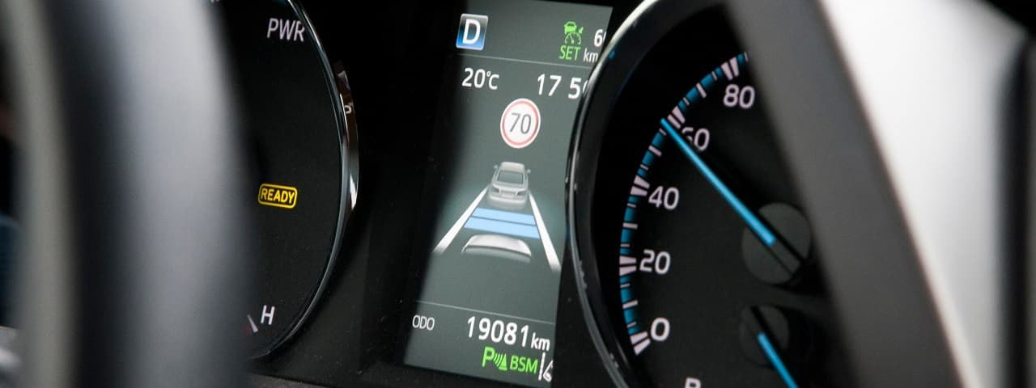
04
Forward Collision Warning

Slide 23
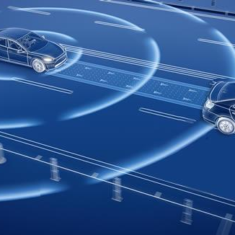
Forward Collision Warning (FCW) is a safety feature designed to prevent or reduce the severity of front-end collisions. The system continuously monitors the road ahead and warns the driver if a vehicle or object is detected too close, giving the driver time to react and avoid a crash
INTRODUCTION

Slide 24
DESCRIPTION
01
Forward Collision Warning (FCW) is an important feature in Advanced Driver Assistance Systems (ADAS).
02
It automatically adjusts a vehicle's speed when there are slow-moving vehicles ahead, with the aim of maintaining a safe following distance.
03
When the path is clear, the FCW system returns the vehicle to the driver's selected speed.
04
These advancements in ADAS are crucial for improving road safety and enhancing the capabilities of autonomous vehicles.

Slide 25
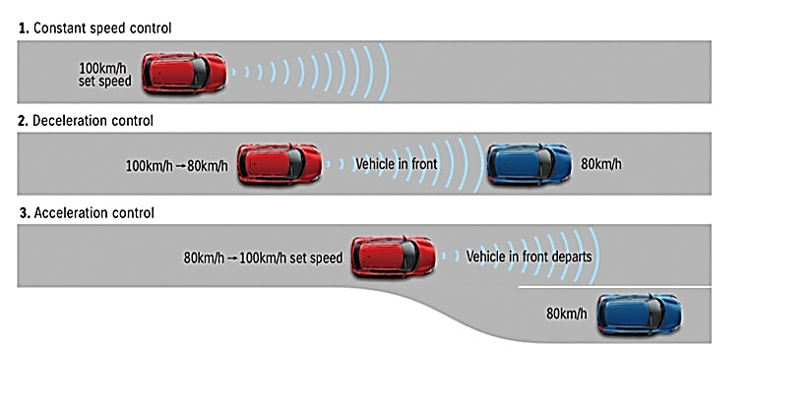
Working Principle
01
Sensing the Road Ahead: FCW uses radar, LiDAR, or cameras to continuously monitor the distance and speed of vehicles or objects in front of the car.
02
Analyzing Distance and Speed: The system calculates the gap between your vehicle and the one ahead, along with their relative speeds, to assess the likelihood of a collision.
03
Predicting Time-to-Collision (TTC): Based on the distance and speed data, FCW determines how soon a collision could occur if neither vehicle adjusts its speed.
04
Issuing a Warning: If the system detects a high risk of collision, it alerts the driver with audible, visual, or tactile warnings, encouraging immediate action to avoid an accident.

Slide 26
Warning Mechanism
When the system detects a potential collision risk, it alerts the driver through a combination of:
Auditory warnings: Beeping sounds or alarms.
Visual warnings: Dashboard lights or head-up display notifications.
If the driver does not act after the warnings, the system can engage automatic measures to help avoid or mitigate the collision.

Slide 27
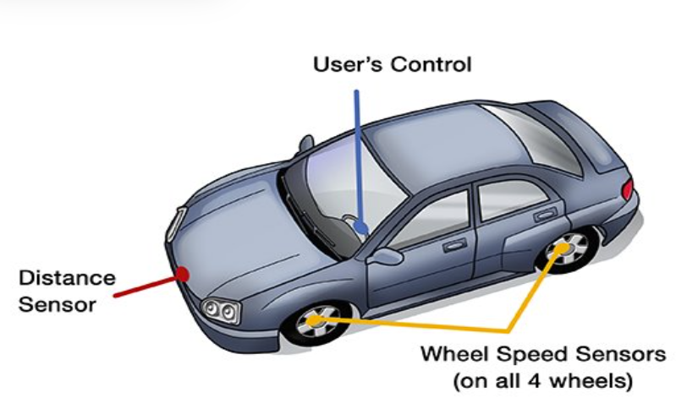
Forward Collision Warning

Slide 28
Sensors
SENSOR is a converter that measures physical quantity and converts it into signal which can be read by observer or by instrument.
SENSOR responds to an input quantity by generating a functionally related output usually in form of electrical or optical signal.
In this project The types of SENSOR can be used:
LiDAR
Ultrasonic

Slide 29
Advantages Of FCW
Driver is relieved from careful acceleration, deceleration and braking in congested traffics.
Accidents can be reduced.
It’s very useful for long driving.
Can avoid unconsciously violating speed limits.
Increased fuel efficiency.

Slide 30
Disadvantages of FCW
High Cost.
Not for heavy traffic.
Encourages the driver to become careless.
Dangerous in slippery roads.
The ACC systems do not respond directly to the traffic

Slide 31
Conclusion
Improving Safety: FCW is a key ADAS feature that helps prevent front-end collisions by alerting the driver and, in some cases, automatically adjusting the vehicle’s speed.
Enhanced Reaction Time: By warning the driver early, FCW provides extra time to react, significantly reducing the risk of accidents
Automated Assistance: When necessary, the system can autonomously limit speed to maintain a safe distance, acting as a backup for human error.
Future Potential: As technology advances, FCW is expected to become even more accurate and reliable, further enhancing vehicle safety.

Slide 32
TABLE OF CONTENTS
01
02
03
04
05
06
INTRODUCTION
Steering Angle Calculations
Blind Spot Detection
Forward Collision Warning
Lane Departure
Conclusion

Slide 33
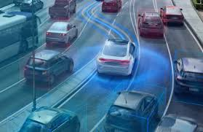
05
Lane Departure

Slide 34
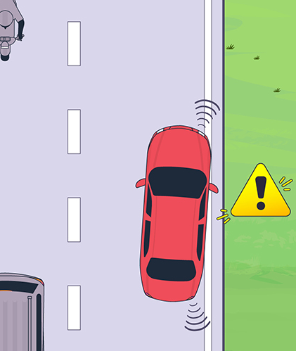
Introduction
It's a critical safety feature that helps drivers stay within their lanes and avoid accidental lane departures. By using cameras and sensors, this advanced technology can detect if a vehicle is drifting out of its lane and provides timely alerts to the driver, reducing the risk of accidents and promoting safer driving.

Slide 35
Types of lane Departure system
Lane Centering Assist (LCA):
Keep The Car Centered In Its Current Lane And Ask The Driver To Take Over In Challenging Situations.
Lane Keeping System (LKS):
Systems Which Warn The Driver And, If No Action Is Taken, Automatically Take Steps To Ensure The Vehicle Stays In Its Lane
Lane Departure Warning (LDW):
Systems Which Warn The Driver If The Vehicle Is Leaving Its Lane.

Slide 36
Advantages Of Lane Departure
Enhanced Safety: Reduced accidents
Reduced Accidents: Better driving
Driver Awareness: LDW systems can improve driver awareness and attentiveness

Slide 37
Disadvantages of Lane Departure
Limited Effectiveness In Certain Conditions: LDW systems less effective in adverse weather; reduced visibility, obscured road markings.
False Alarms: LDW systems prone to false alarms, driver annoyance, and distraction

Slide 38
Lane departure system
The methods for lane departure warning can be classified into two categories:
1. Sensor-based methods.
2. Vision-based methods
Sensor-based methods:
Use devices such as radar or laser sensors to detect whether a vehicle departed a lane based on:
Information of the vehicle ahead.

Slide 39
Vision-based methods
It detects the road lanes based on the features of a camera image such as color gradient, histogram, or edge.
Model-based methods: These create a mathematical model of the road using geometric coordinates of the camera and road. The accuracy of detection relies on precise input parameters and the road's shape, represented by feature points from images.
Feature-based methods: These distinguish lane features from non-lane areas using characteristics like color, gradient, or edge. This method is simpler but depends on strong color contrast and stable road conditions.

Slide 40

We are glad Presenting For You
We are ready for discussion
Thank you.

